Slide 1
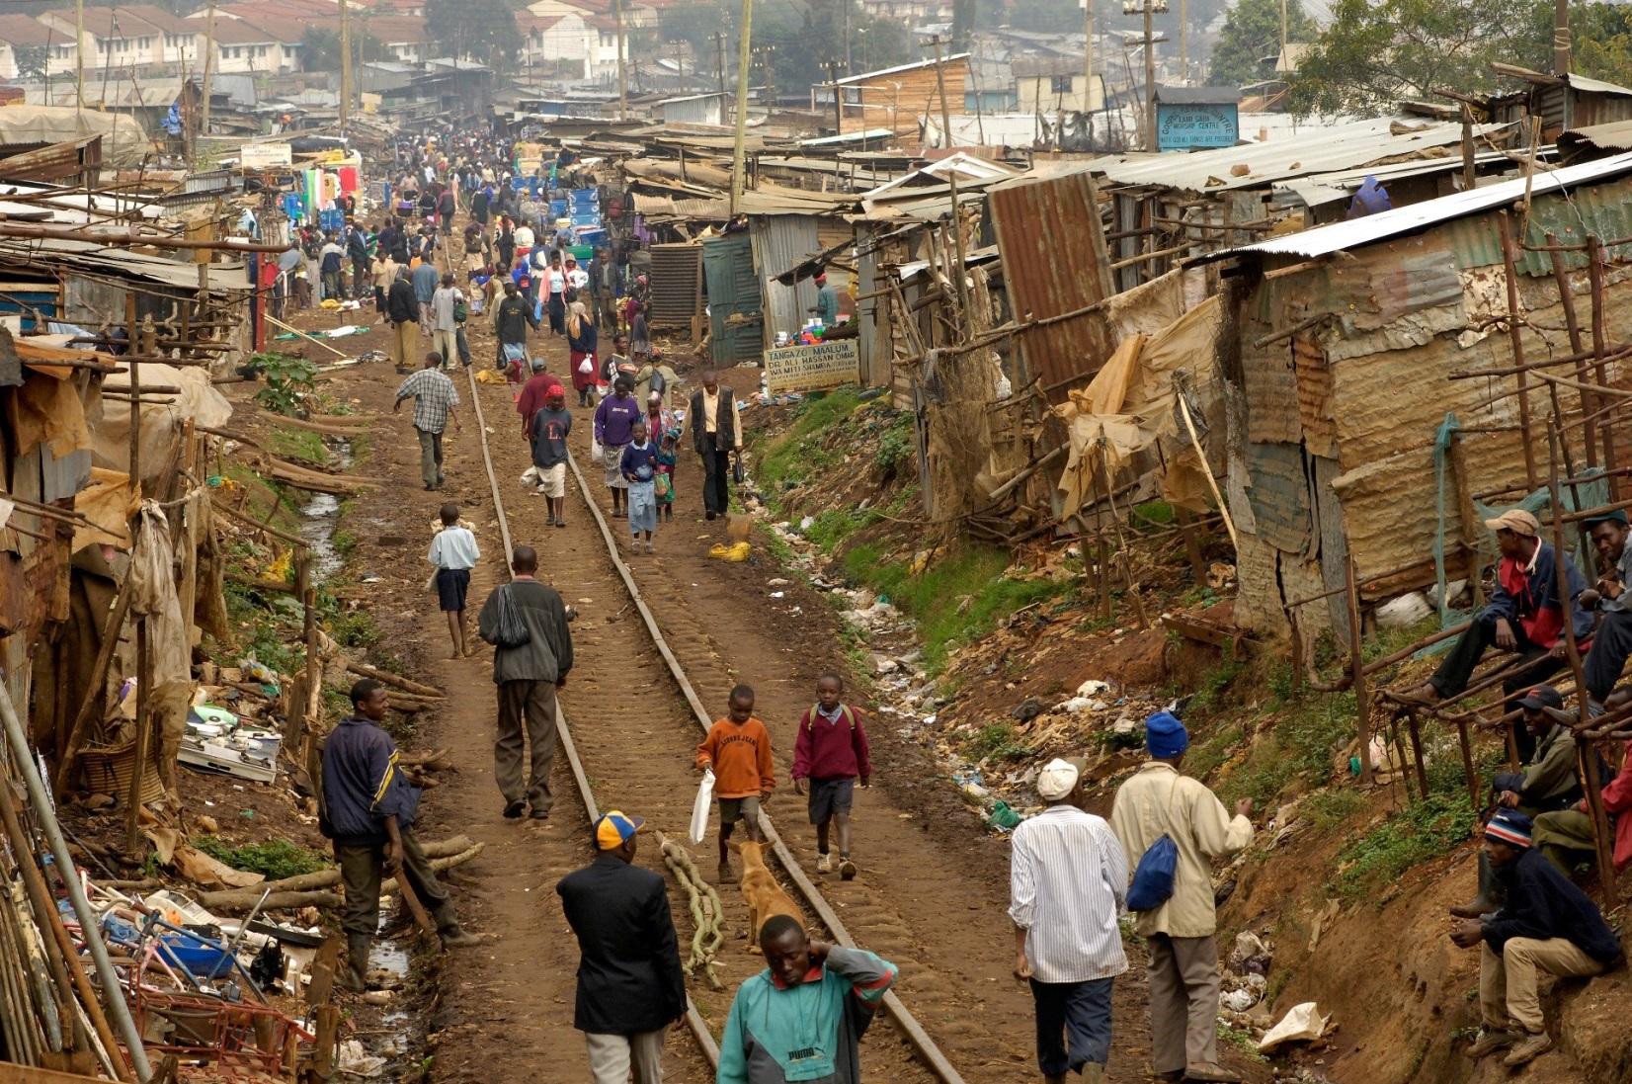
Human Wellbeing
Development, Global inequalities and Poverty

Slide 2
Mini quiz
1. Name two countries that you think of as developed and two that you think of as developing.

Slide 3
Mini quiz
2. Poverty exists only in developing countries. True or false?

Slide 4
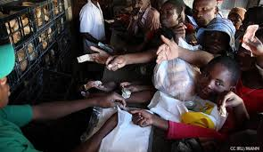
What is human wellbeing?
Refers to people’s quality of life
Takes into account the extent to which an individual, group or country can be characterised as being healthy, happy and prosperous.

Slide 5
Development
It can be defined as the outcome of economic growth
or in terms of a socio-economic process, the aim of which is to provide a sustained improvement in people’s quality of life.
It is often measured by the rate of economic growth
Growth is measured by the consumption of goods and services.

Slide 6

However…
There is a belief that wellbeing is dependant on money but this does not necessarily being about happiness.
What do you think is important for happiness?

Slide 7
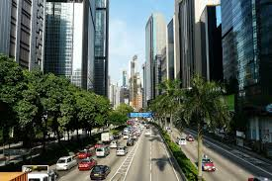
Developed Countries
a rich, industrialised country of the world

Slide 8
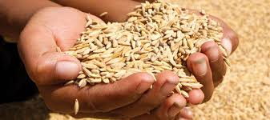
Developing Countries
a poor or middle-income country often dependent on subsistence farming.

Slide 9
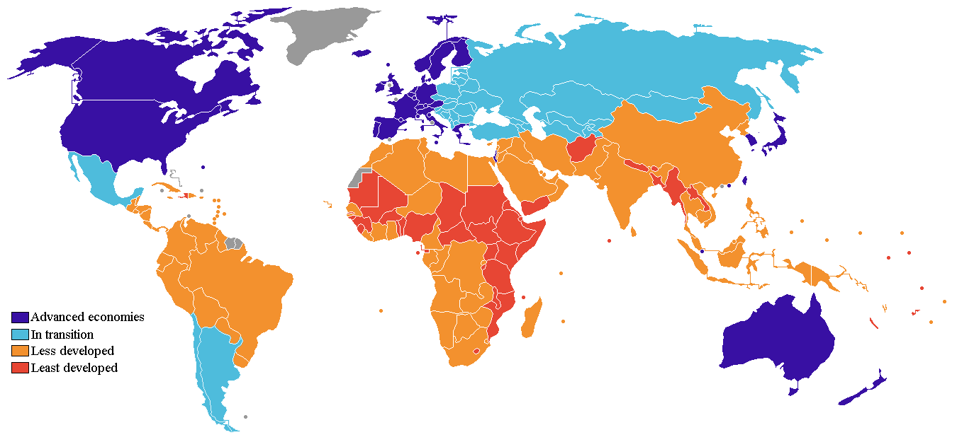
Map showing developed and developing world

Slide 10
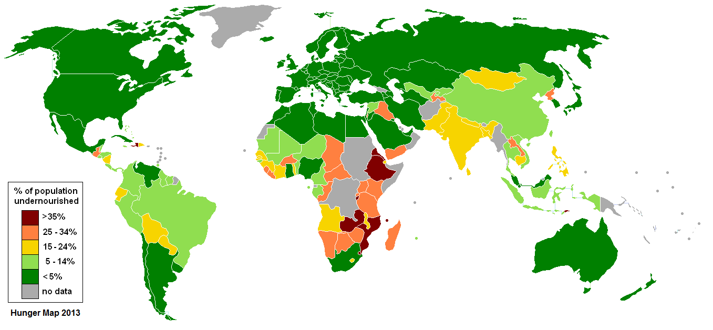
Map showing malnutrition

Slide 11
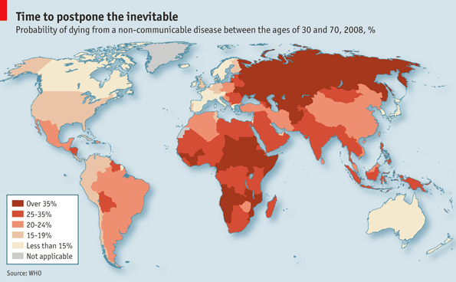
Map showing probability of dying from communicable diseases

Slide 12
What patterns can we see?
PATTERN
QUANTITY
EXCEPTION
With a partner examine the Atlas on page 34-35
Write down two patterns you can see in each of the maps.
Which parts of the world suffer the most from lack of water and food?
Does this also affect health and education?
Find a continent that contains a country that is ‘developing’. Locate the map for it and write down two key facts for that Continent.

Slide 13
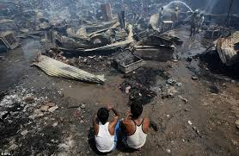
Poverty
A term used to define an individual or group of people who lack the essential resources and services to enjoy a minimum standard of health and wellbeing

Slide 14
Key features of developed countries

Slide 15
Key features of developing countries

Slide 16
Draw up a table with these headings
Social conditions | Environmental conditions | Economic conditions
We will examine a picture of the living conditions in New Delhi in India. Take down notes on what you think life would be like here.

Slide 17
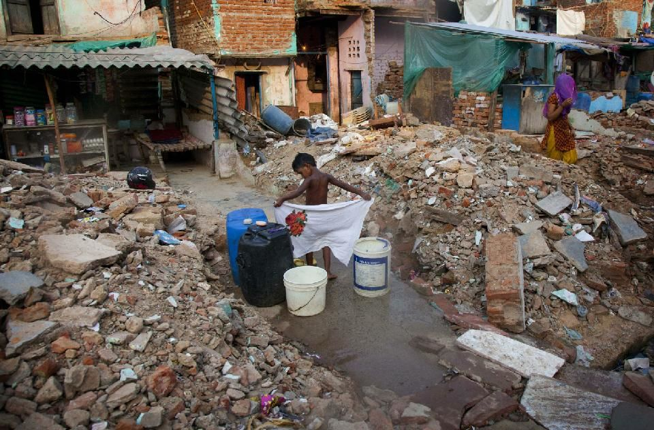
slums of New Delhi
slums of New Delhi

